Slide 1
Design of a solver based on
physics-informed neural networks
①
②
③
Denoising Hamiltonian Network for Physical Reasoning
General Hamiltonian Neural Networks for Dynamic Modeling: Handling Sophisticated Constraints Automatically and Achieving Coordinates Free
Distance-Informed Neural Eikonal Solver for Reactive Dynamic User-Equilibrium of MacroscopicContinuum Traffic Flow Model
④
⑤
Kolmogorov-Arnold Network for Solving 2-D Magnetostatic Problems
Deep Statistical Solver for Distribution
System State Estimation
CPS Computational Learning Laboratory

Slide 2

②
General Hamiltonian Neural Networks for Dynamic Modeling: Handling Sophisticated Constraints Automatically and Achieving Coordinates Free
Hamiltonian structuren
Emphasizing the role of numerical calculations
①
③
Denoising Hamiltonian Network for Physical Reasoning
Distance-Informed Neural Eikonal Solver for Reactive Dynamic User-Equilibrium of MacroscopicContinuum Traffic Flow Model
Processing of neighborhood information
KAN structure
⑤
④
Deep Statistical Solver for Distribution
System State Estimation
Kolmogorov-Arnold Network for Solving 2-D Magnetostatic Problems
CPS Computational Learning Laboratory

Slide 3

Paper 1
Denoising Hamiltonian Network for Physical Reasoning
Congyue Deng, Brandon Y. Feng, Cecilia Garraffo, Alan Garbarz, Robin Walters, William T. Freeman, Leonidas Guibas,Kaiming He
Published in: arXiv
Published Time: 2025
CPS Computational Learning Laboratory

Slide 4
01
Problem Description
02
Method Design
03
Experiment Results
Contents
04
Conclusion
CPS Computational Learning Laboratory

Slide 5
01
Problem Description
02
Method Design
03
Experiment Results
Contents
04
Conclusion
CPS Computational Learning Laboratory

Slide 6
Problem Description
Machine learning frameworks for physical problems must capture and enforce physical constraints that preserve the structure of dynamicalsystems. While existing methods offer theoretical guarantees, they face two key limitations:
(1) they primarily model local relations between adjacenttime steps, overlooking longer-range or higher level physical interactions,
(2) they focus on forward simulation while neglecting broader physical reasoning tasks.
Cloud-edge collaborative artificial intelligence service with evolved DRL agents can be a
significant scenario.
However, agents with different algorithms and architectures in the same DRL scenario may not be compatible, and training them is either time-consuming or resource-demanding.
CPS Computational Learning Laboratory

Slide 7
01
Problem Description
02
Method Design
03
Experiment Results
Contents
04
Conclusion
CPS Computational Learning Laboratory

Slide 8
Method Design
This paper propose the Denoising Hamiltonian Network (DHN), a novel framework that generalizes Hamiltonian mechanics operators into more flexible neural operators.
DHN captures non-local temporal relationships and mitigates numerical integration errors through a denoising mechanism，also supports multi-system modeling with a global conditioning mechanism.
CPS Computational Learning Laboratory

Slide 9
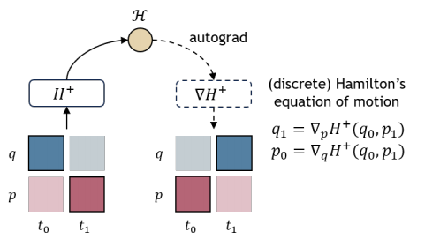
Method Design
1. Motivation
CPS Computational Learning Laboratory

Slide 10
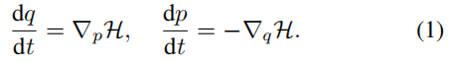
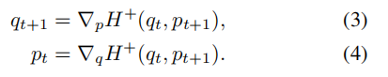
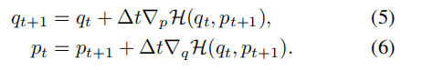
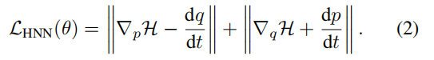
Method Design
2. Preliminaries
（1）Learning with Hamiltonian mechanics
（3）Discrete Hamiltonian
（2）Hamiltonian Neural Networks (HNN)
CPS Computational Learning Laboratory
Notes:
CQL：保守强化学习，主要解决模型对未见过动作的价值过估计问题，通过在损失函数中加入L_CQL约束项实现
公式7是对公式5中最大动作价值进行了一个近似

Slide 11
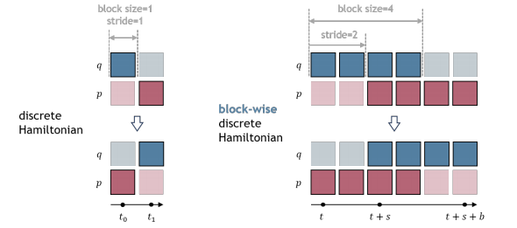
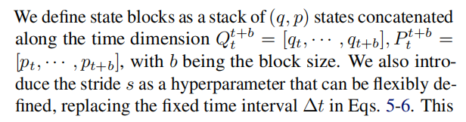
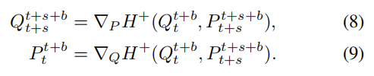
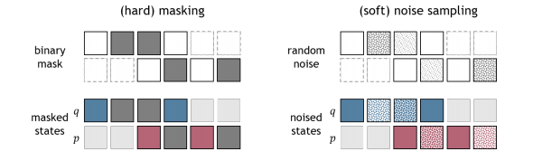
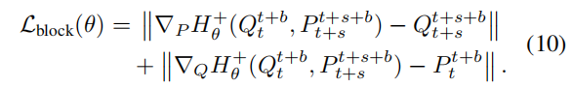
Method Design
3. Block-Wise Discrete Hamiltonian
CPS Computational Learning Laboratory
Notes:
CQL：保守强化学习，主要解决模型对未见过动作的价值过估计问题，通过在损失函数中加入L_CQL约束项实现
公式7是对公式5中最大动作价值进行了一个近似

Slide 12
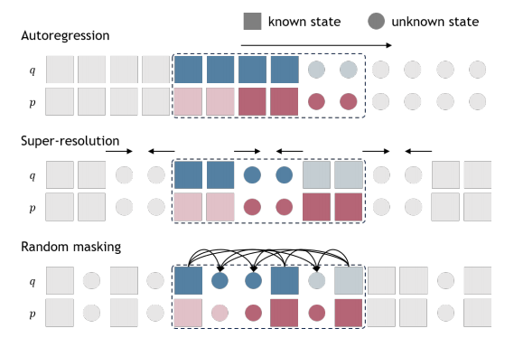
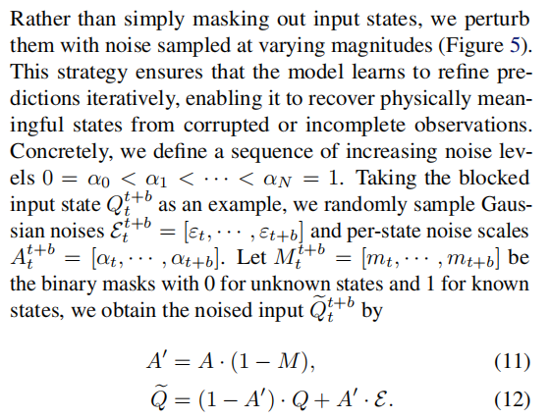
Method Design
4. Denoising Hamiltonian Network
（1）Masked modeling and denoising
CPS Computational Learning Laboratory
Notes:
CQL：保守强化学习，主要解决模型对未见过动作的价值过估计问题，通过在损失函数中加入L_CQL约束项实现
公式7是对公式5中最大动作价值进行了一个近似

Slide 13
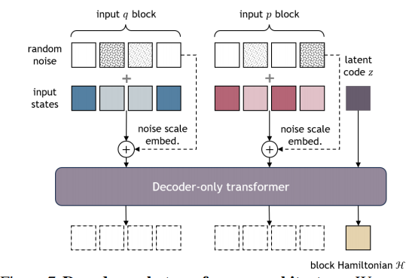
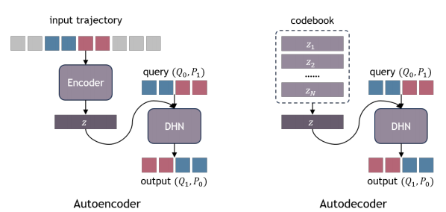
Method Design
4. Denoising Hamiltonian Network
（2）Different masking patterns
CPS Computational Learning Laboratory
Notes:
CQL：保守强化学习，主要解决模型对未见过动作的价值过估计问题，通过在损失函数中加入L_CQL约束项实现
公式7是对公式5中最大动作价值进行了一个近似

Slide 14
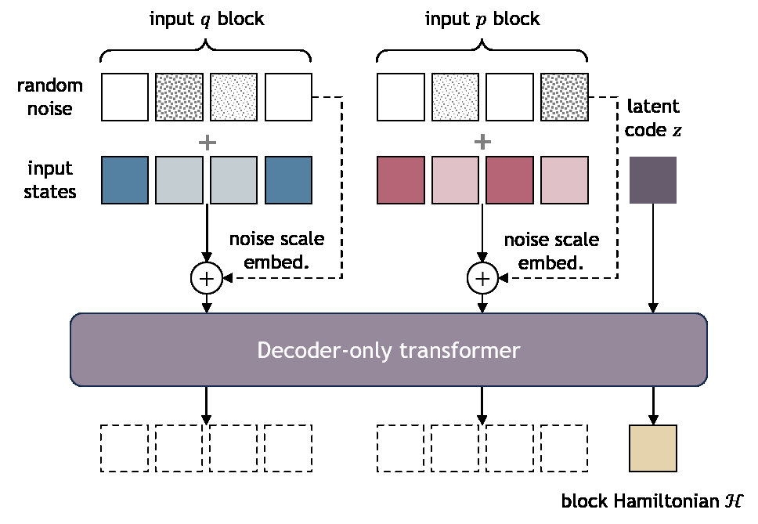
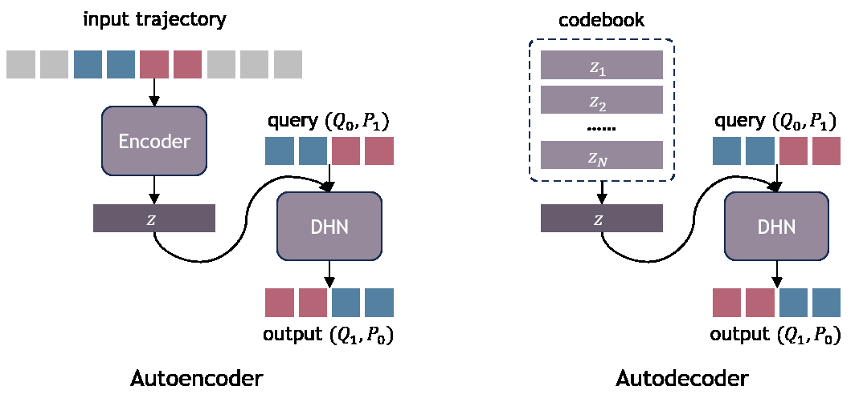
Method Design
5. Network Architecture
（1）Decoder-only transformer
（2）Autodecoding
CPS Computational Learning Laboratory
Notes:
CQL：保守强化学习，主要解决模型对未见过动作的价值过估计问题，通过在损失函数中加入L_CQL约束项实现
公式7是对公式5中最大动作价值进行了一个近似

Slide 15
01
Problem Description
02
Method Design
03
Experiment Results
Contents
04
Conclusion
CPS Computational Learning Laboratory

Slide 16
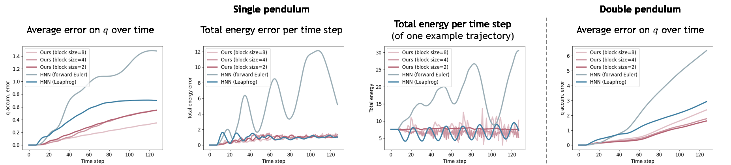
Experiment Results
1. Forward Simulation
(1)Fitting known trajectories
CPS Computational Learning Laboratory
Notes:
offline智能体使用专家水平离线数据集，
AIKD-BASE：损失函数采用公式10
AIKD-RKD：损失函数采用公式11
OTO算法比QRDQN快2-10倍

Slide 17
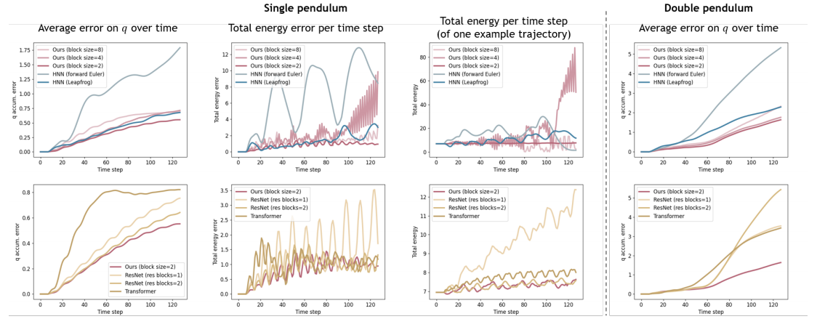
Experiment Results
1. Forward Simulation
(2)Completion on novel trajectories
CPS Computational Learning Laboratory
Notes:
offline智能体使用专家水平离线数据集，
AIKD-BASE：损失函数采用公式10
AIKD-RKD：损失函数采用公式11
OTO算法比QRDQN快2-10倍

Slide 18
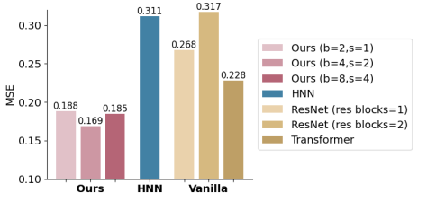
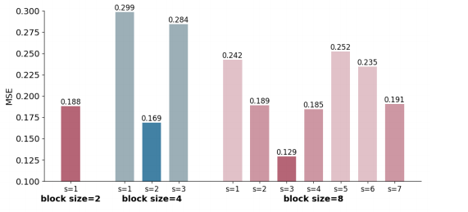
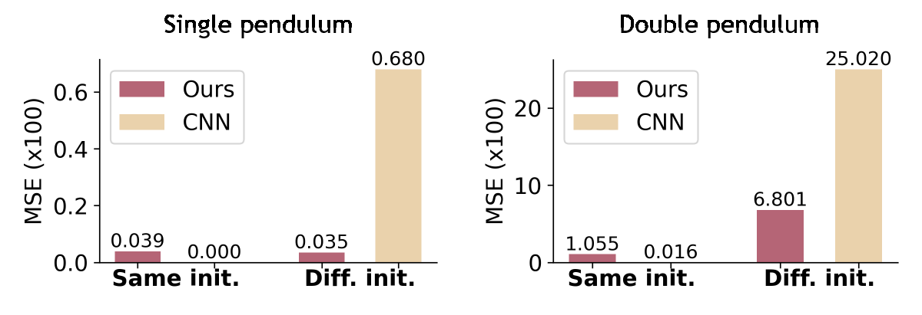
Experiment Results
2. Representation Learning
3. Trajectory Interpolation
CPS Computational Learning Laboratory
Notes:
offline智能体使用专家水平离线数据集，
AIKD-BASE：损失函数采用公式10
AIKD-RKD：损失函数采用公式11
OTO算法比QRDQN快2-10倍

Slide 19
01
Problem Description
02
Method Design
03
Experiment Results
Contents
04
Conclusion
CPS Computational Learning Laboratory
CPS Computational Learning Laboratory
2
18

Slide 20
Conclusion
(1) DHN extends Hamiltonian neural operators to capture non-local temporal relationships by treating groups of system states as tokens, allowing it to reason holistically about system dynamics rather than in isolated steps.
(2) DHN integrates a denoising objective to mitigate numerical integration errors and enhance stability in long-term forecasting while remaining adaptable across diverse noise conditions.
(3) This work introduce global conditioning to facilitate multisystem modeling, enabling DHN to model heterogeneous physical systems under a unified framework while maintaining disentangled representations of underlying dynamics.
CPS Computational Learning Laboratory
Notes:
(1) DHN 扩展了汉密尔顿神经算子，通过将系统状态组作为标记来捕捉非局部的时间关系，从而能够整体地而不是孤立地推理系统动态。
(2) DHN 集成了去噪目标，以减少数值积分误差，提高长期预测的稳定性，同时还能适应各种噪声条件。
(3) 这项工作引入了全局条件来促进多系统建模，使 DHN 能够在统一的框架下对异构物理系统进行建模，同时保持底层动力学的分离表征。

Slide 21
Paper 2
General Hamiltonian Neural Networks for Dynamic
Modeling: Handling Sophisticated Constraints
Automatically and Achieving Coordinates Free
Yanfang Liu , Xu Wang , Yituo Song, Bo Wang, and Desong Du
Publish Journal: IEEE TRANSACTIONS ON NEURAL NETWORKS AND LEARNING SYSTEMS
Published Time: 2025
CPS Computational Learning Laboratory

Slide 22
01
Problem Description
02
Method Design
03
Experiment Results
Contents
04
Conclusion
CPS Computational Learning Laboratory

Slide 23
01
Problem Description
02
Method Design
03
Experiment Results
Contents
04
Conclusion
CPS Computational Learning Laboratory

Slide 24
Problem Description
Data-driven physical reasoning models often require systems to be represented in canonical (position-momentum) coordinates, which are typically unknown in real-world observations. Existing solutions suffer from limited generality and training difficulties:
(1) Coordinate dependence – Require canonical (position-momentum) coordinates, which are usually unobserved, and generalize poorly to other representations.
(2) Extra information needed – Often rely on high-order derivatives or prior knowledge of the true Hamiltonian, limiting practical applicability.
(3) High computational complexity – Physics-informed NNs involve intricate computational graphs, making gradient descent unstable and training difficult.
CPS Computational Learning Laboratory

Slide 25
01
Problem Description
02
Method Design
03
Experiment Results
Contents
04
Conclusion
CPS Computational Learning Laboratory

Slide 26
Method Design
The methodology for this work is as follows:
(1) Introducing a novel Hamiltonian framework for dynamic systems in general coordinates.
(2)Developing NNs with the proposed general Hamiltonian framework to learn dynamics from data efficiently, achieve coordinate free and handle complex constraints
automatically.
(3) Designing a novel training approach to ensure robust convergence, incorporating an efficient loss function that covers both accuracy and energy conservation.
(4) Phase figures for simulations and time domain plots for experiments are reported and compared in various cases.
CPS Computational Learning Laboratory

Slide 27
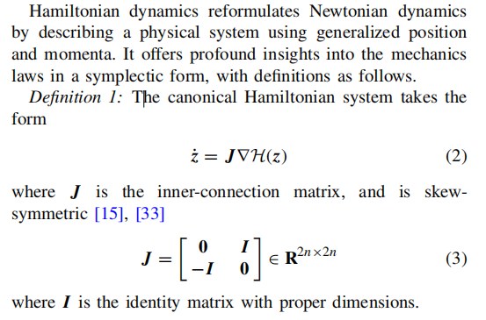
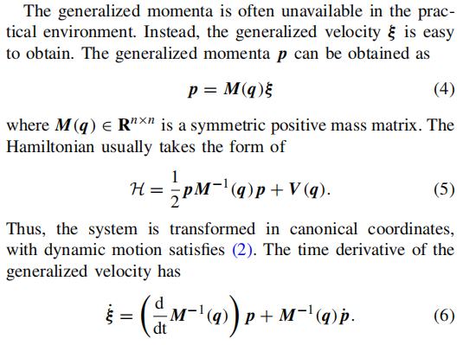
Method Design
1. PRELIMINARIES AND HAMILTONIAN MECHANICS
A. Hamiltonian Mechanics
B. Hamiltonian Mechanics With Only Velocity Observed
CPS Computational Learning Laboratory

Slide 28
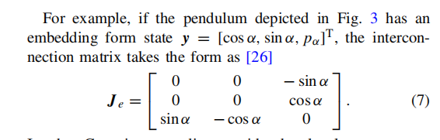
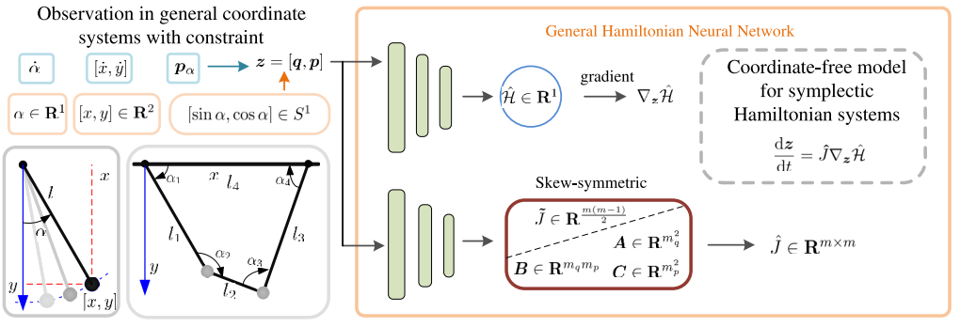
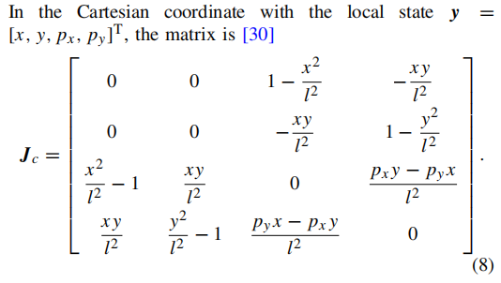
Method Design
1. PRELIMINARIES AND HAMILTONIAN MECHANICS
C. Hamiltonian Mechanics Under Local Coordinates
CPS Computational Learning Laboratory

Slide 29
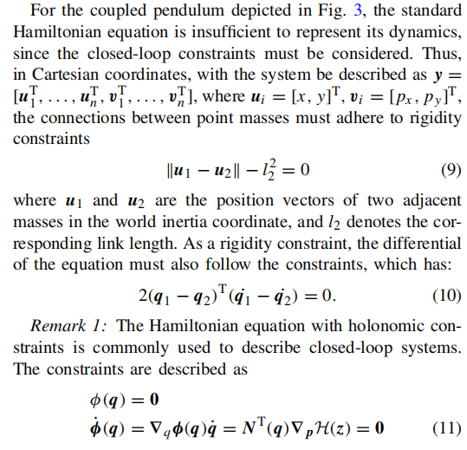
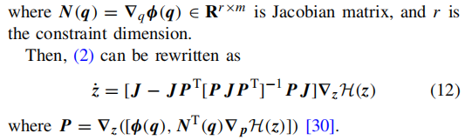
Method Design
1. PRELIMINARIES AND HAMILTONIAN MECHANICS
D. Hamiltonian Mechanics With Constraints
CPS Computational Learning Laboratory

Slide 30
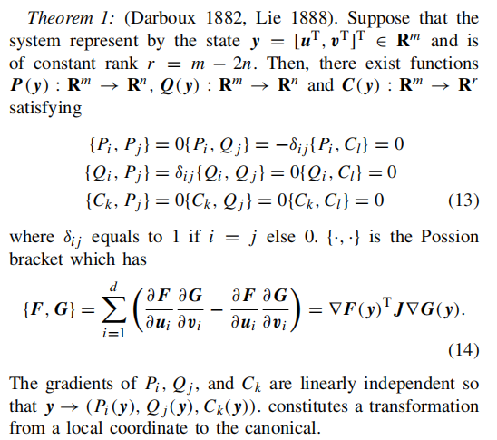
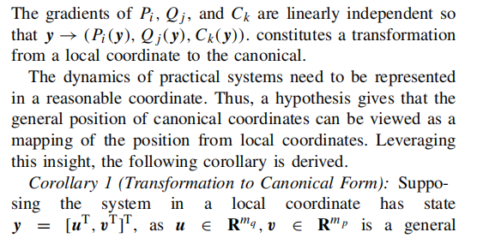
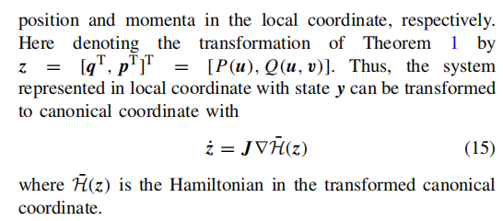
Method Design
1. PRELIMINARIES AND HAMILTONIAN MECHANICS
E. Coordinate Changes and the Darboux-Lie Theorem
CPS Computational Learning Laboratory

Slide 31
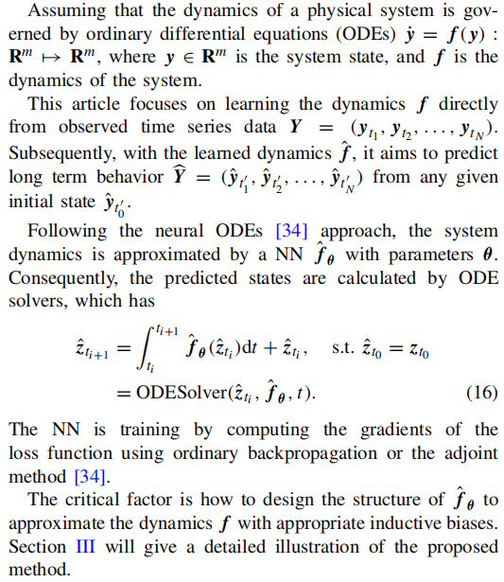
Method Design
1. PRELIMINARIES AND HAMILTONIAN MECHANICS
F. Learning Dynamic From Data
CPS Computational Learning Laboratory

Slide 32
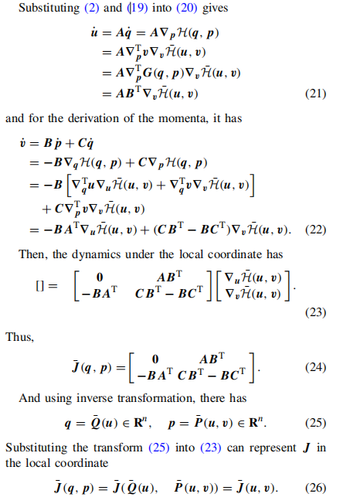
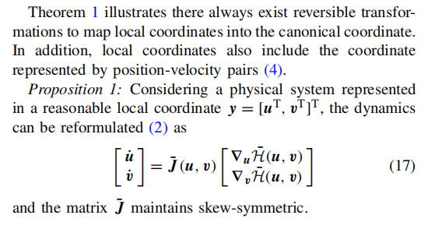
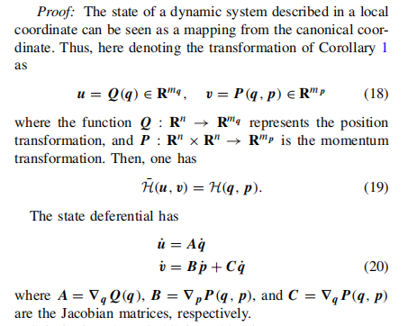
Method Design
2. METHODS
A. General Hamiltonian Mechanics
CPS Computational Learning Laboratory

Slide 33
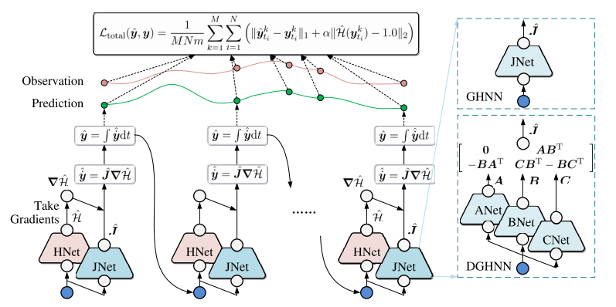
Method Design
2. METHODS
B. General HNNs
CPS Computational Learning Laboratory

Slide 34
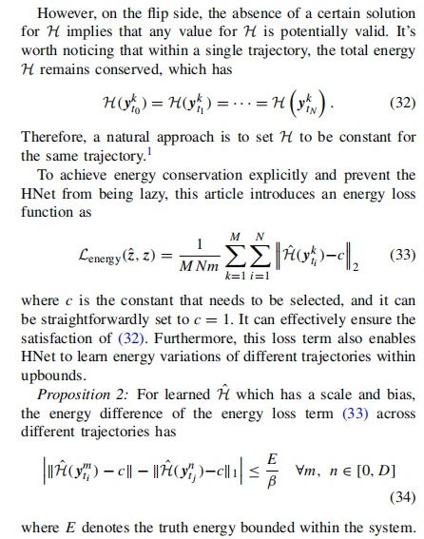
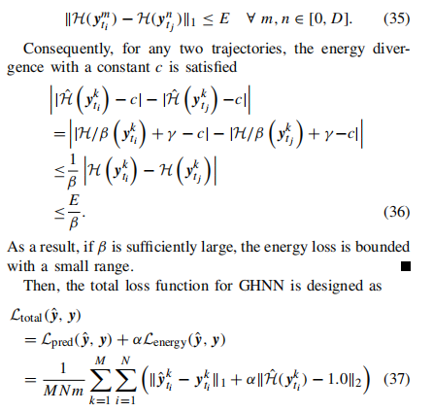
Method Design
2. METHODS
C. Loss Function Design
CPS Computational Learning Laboratory

Slide 35
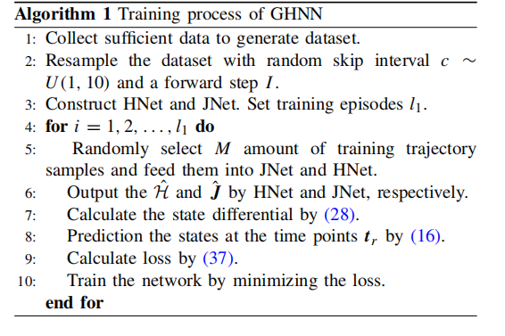
Method Design
2. METHODS
D. Random Resampled Method for the Dataset Enhancement
CPS Computational Learning Laboratory

Slide 36
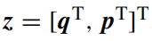
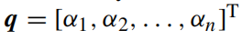
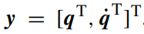
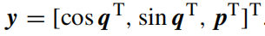
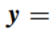
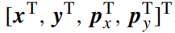
Method Design
3. EXPERIMENTS
A. Experiment Setup and Training Details
To demonstrate the effectiveness of GHNN, simulations, and experiments on various dynamic systems using different coordinates are conducted. The main evaluation task is long-term trajectory prediction,
The following coordinates are considered for simulations.
1) Canonical Coordinate:
2) Velocity Coordinate:
3) S1 Space:
4) Cartesian Coordinate:
The GHNN is compared with several existing models as follows.
1) The NODE model.
2) The HNN model.
3) The NSF model2.
4) The CHNN model3.
CPS Computational Learning Laboratory

Slide 37
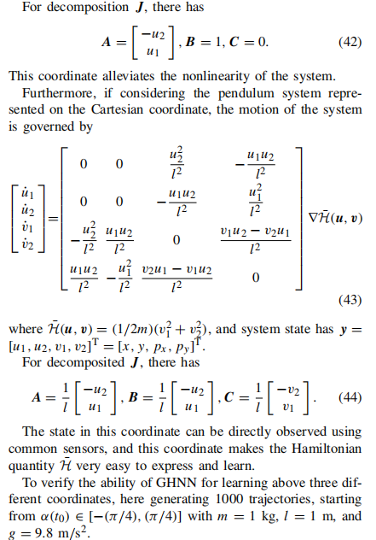
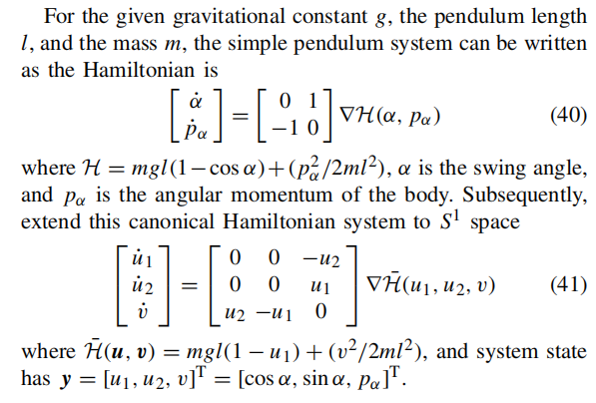
Method Design
3. EXPERIMENTS
B. Simple Pendulum System
CPS Computational Learning Laboratory

Slide 38
01
Problem Description
02
Method Design
03
Experiment Results
Contents
04
Conclusion
CPS Computational Learning Laboratory

Slide 39
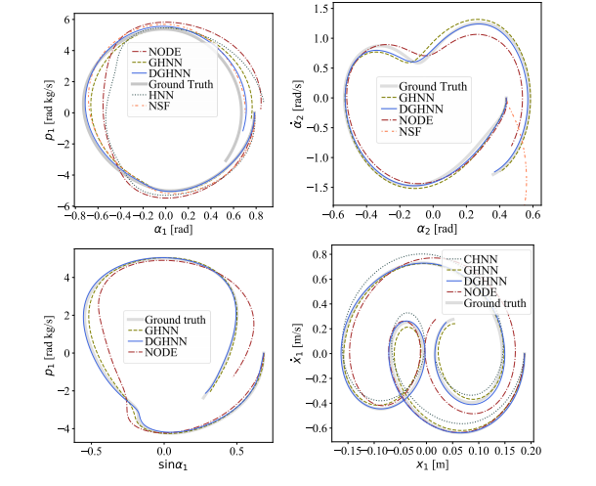
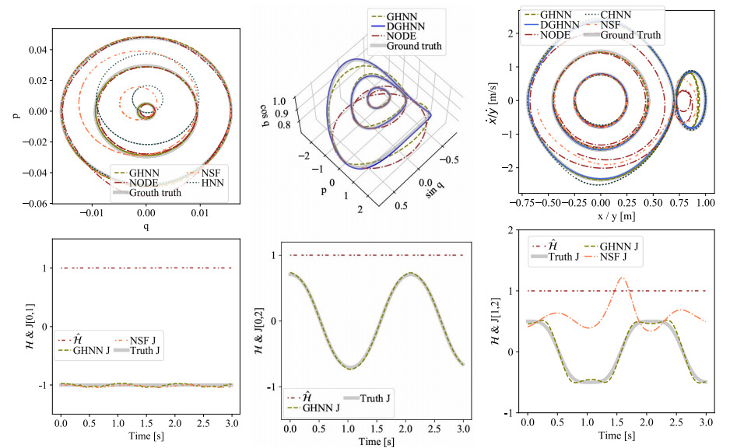
Method Design
3. EXPERIMENTS
B. Simple Pendulum System
C. Double Pendulum System
CPS Computational Learning Laboratory

Slide 40
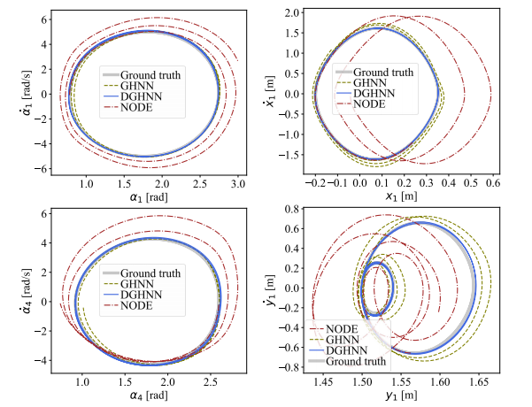


Method Design
3. EXPERIMENTS
D. Coupled Pendulum System
CPS Computational Learning Laboratory

Slide 41



Method Design
3. EXPERIMENTS
E. Real 3-D Crane
CPS Computational Learning Laboratory

Slide 42








Method Design
4. ANALYZE OF RANDOM RESAMPLE METHOD
CPS Computational Learning Laboratory

Slide 43
01
Problem Description
02
Method Design
03
Experiment Results
Contents
04
Conclusion
CPS Computational Learning Laboratory
CPS Computational Learning Laboratory
2
18

Slide 44
Conclusion
This article proposes a versatile and generalized Hamiltonian framework integrated with neural networks to form the GHNN model. GHNN is designed to capture dynamics in arbitrary coordinate systems and automatically handle complex constraints. The proposed method demonstrates accurate predictions across various coordinate representations and exhibits strong robustness in practical applications.
CPS Computational Learning Laboratory

Slide 45
Paper 3
Distance-Informed Neural Eikonal Solver for
Reactive Dynamic User-Equilibrium of Macroscopic
Continuum Traffic Flow Model
Yun Ye , Member, IEEE, Haoyang Liang , Member, IEEE, Jian Sun , Member, IEEE, and Xiqun Chen
Publish Journal: IEEE TRANSACTIONS ON INTELLIGENT TRANSPORTATION SYSTEMS
Published Time: 2025
CPS Computational Learning Laboratory

Slide 46
01
Problem Description
02
Method Design
03
Experiment Results
Contents
04
Conclusion
CPS Computational Learning Laboratory

Slide 47
01
Problem Description
02
Method Design
03
Experiment Results
Contents
04
Conclusion
CPS Computational Learning Laboratory

Slide 48
Problem Description
Existing FMM and FSM h in solving RDUE problems encounter challenges in meeting the precision and efficiency requirements when addressing complex scenarios.
(1) The precision of the solution obtained via the methods hinges on the maximum cell size post-discretization within the computational domain. This requirement precipitates a substantial surge in the computational cost.
(2) Employing high-order finite difference schemes introduces additional complexities. The extrapolation of the ghost-points in the widestencil will also dampen the accuracy of solutions and even hinder convergence.
CPS Computational Learning Laboratory

Slide 49
01
Problem Description
02
Method Design
03
Experiment Results
Contents
04
Conclusion
CPS Computational Learning Laboratory

Slide 50
Method Design
(1) This research leverage PINNs for solving PDEs in 2D macroscopic traffic flow analyses, thereby providing a viable framework for solving traffic models with PDEs.
(2) The proposed NES-DI method utilizes the factorization form of the distance function equation, and separates the distance information component from the neural network fitting component, thereby well integrating numerical methods and PINNs.
(3) A transfer learning technique is proposed to solve the RDUE problem at the dynamic level, which enables the information of the previous time step to be utilized in the current time step to improve efficiency while maintaining accuracy
CPS Computational Learning Laboratory

Slide 51





Method Design
A. Static Eikonal Equation
B. Reactive Dynamic User-Equilibrium Model
CPS Computational Learning Laboratory

Slide 52





Method Design
2. PHYSICS-INFORMED NEURAL NETWORKS
Step 1. Transform Eikonal equation into factorized Eikonal equation;
Step 2. Determine the distance distribution using FSM or FMM;
Step 3. Build fully connected neural networks for the prediction of factorized solutions;
Step 4. Set a proper loss function, which includes the Hamiltonian form of Eikonal equation;
Step 5. Train the neural network with the weights initialized by Kaiming initialization until the error estimation reaches expectation.
A. NES for Factorized Eikonal Equation
C. Loss Function
B. Distance-Informed Approach
CPS Computational Learning Laboratory

Slide 53

Method Design
2. PHYSICS-INFORMED NEURAL NETWORKS
D. Algorithm Architecture
CPS Computational Learning Laboratory

Slide 54

Method Design
2. PHYSICS-INFORMED NEURAL NETWORKS
D. Algorithm Architecture
CPS Computational Learning Laboratory

Slide 55
01
Problem Description
02
Method Design
03
Experiment Results
Contents
04
Conclusion
CPS Computational Learning Laboratory

Slide 56




Method Design
3. NUMERICAL EXAMPLES
A. Example 1: Trigonometric Eikonal Equation (Static)
CPS Computational Learning Laboratory

Slide 57


Method Design
3. NUMERICAL EXAMPLES
A. Example 1: Trigonometric Eikonal Equation (Static)
CPS Computational Learning Laboratory

Slide 58



Experiment Results
B. Example 2: Modeling of Cost Potential in Urban Cities (Static)
CPS Computational Learning Laboratory

Slide 59





Experiment Results
C. Example 3: RDUE for Pedestrian Dynamics (Dynamic)
CPS Computational Learning Laboratory

Slide 60


Experiment Results
C. Example 3: RDUE for Pedestrian Dynamics (Dynamic)
CPS Computational Learning Laboratory

Slide 61


Experiment Results
C. Example 3: RDUE for Pedestrian Dynamics (Dynamic)
CPS Computational Learning Laboratory

Slide 62
01
Problem Description
02
Method Design
03
Experiment Results
Contents
04
Conclusion
CPS Computational Learning Laboratory
CPS Computational Learning Laboratory
2
18

Slide 63
Conclusion
This work proposed a PINNs-based framework, NES-DI, for solving the Eikonal equation within the RDUE model of macroscopic continuum traffic flow. To address the limitations of traditional NES, the approach leverages a factorized form of the Eikonal equation and incorporates a simple numerical method to enhance the accuracy of distance estimation. Additionally, this work introduced LUSR, which employs a domain-general latent embedding as the state representation.
CPS Computational Learning Laboratory

Slide 64
Paper 4
Kolmogorov-Arnold Network for Solving 2-D
Magnetostatic Problems
Yachao Zhu, Student Member, Kai Xu, Bingkuan Wan, Gang Lei, Senior Member, IEEE and Jianguo Zhu
Senior Member, IEEE
Published in: IEEE Transactions on Magnetics
Published Time: 2025
CPS Computational Learning Laboratory

Slide 65
01
Problem Description
02
Method Design
03
Experiment Results
Contents
04
Conclusion
CPS Computational Learning Laboratory

Slide 66
01
Problem Description
02
Method Design
03
Experiment Results
Contents
04
Conclusion
CPS Computational Learning Laboratory

Slide 67
Problem Description
Most current PINN research relies on multilayer perceptrons (MLPs) using fully connected feed-forward networks. These highly nonlinear neural networks have complex multilayer structures, making it difficult to understand how they make decisions or extract features and weights. PINN activation functions are predetermined before training, requiring multiple trials or experience-based selection to identify suitable configurations. Additionally, PINNs are highlysensitive to hyperparameters (learning rate, layers number, regularisation), which significantly affect performance.
CPS Computational Learning Laboratory

Slide 68
01
Problem Description
02
Method Design
03
Experiment Results
Contents
04
Conclusion
CPS Computational Learning Laboratory

Slide 69
Method Design
This study applies KAN to solve 2-D magnetostatic field problems, exploring its practical applications in computational electromagnetics. A KAN-based model is constructed, and the optimal hyperparameters are evaluated to solve the vector potential of magnetostatic fields within PDEs. Additionally, a transfer learning approach is employed to validate the model's generalization ability and flexibility.
CPS Computational Learning Laboratory

Slide 70

Method Design
1. ELECTROMAGNETIC THEORY
CPS Computational Learning Laboratory
Notes:
把目标域中的策略按照状态价值进行聚类，分成n个簇
公式（2）：从源域抽取若干个状态，计算源域中每个智能体在这组状态下的状态价值
公式（3）：yi，第i个源域智能体状态价值向量
GMM：生成n个混合高斯分布，用n个高斯分布来拟合n’组数据，就是将n个智能体的数据进行聚类
公式（4）：计算每个数据在数据在每个高斯分布下的概率密度，代表第i个源域智能体的数据在第k个高斯分布下的概率密度，
乘上权重，代表第i个数据在这个混合高斯分布下的概率密度，
再相乘，代表这组数据在这个混合高斯分布下的概率密度
公式（6）：每个簇要挑选m组源域智能体数据（给每个智能体分配m个预训练的源域智能体策略），每个簇要使这个联合概率密度最大，也就是让这m组数据来自于这个簇的概率最大

Slide 71


Method Design
2. KOLMOGOROV-ARNOLD NETWORK (KAN) ARCHITECTURE
A. KAN Structure
CPS Computational Learning Laboratory

Slide 72
01
Problem Description
02
Method Design
03
Experiment Results
Contents
04
Conclusion
CPS Computational Learning Laboratory

Slide 73



Method Design
2. KOLMOGOROV-ARNOLD NETWORK (KAN) ARCHITECTURE
B. KAN hyperparameters
CPS Computational Learning Laboratory

Slide 74


Method Design
3. NUMERICAL EXAMPLES
A. High interpretability
CPS Computational Learning Laboratory

Slide 75

Method Design
3. NUMERICAL EXAMPLES
B. High accuracy of KAN
CPS Computational Learning Laboratory

Slide 76
Method Design
3. NUMERICAL EXAMPLES
C. Efficient convergence of KAN
CPS Computational Learning Laboratory

Slide 77

Method Design
3. NUMERICAL EXAMPLES
D. Generalizability and flexibility of KAN
CPS Computational Learning Laboratory

Slide 78
01
Problem Description
02
Method Design
03
Experiment Results
Contents
04
Conclusion
CPS Computational Learning Laboratory
CPS Computational Learning Laboratory
2
18

Slide 79
Conclusion
This study explored the practical application of KAN in 2-D computational magnetostatic problems. KAN delivers accurate solutions for both square and circular geometries while offering strong interpretability. Moreover, KAN achieves convergence with significantly fewer training steps and higher efficiency, requiring far fewer hyperparameters compared to MLP-PINN.
CPS Computational Learning Laboratory

Slide 80
Paper 5
Deep Statistical Solver for Distribution
System State Estimation
Benjamin Habib , Elvin Isufi , Member, IEEE, Ward van Breda, Arjen Jongepier ,and Jochen L. Cremer , Member, IEEE
Publish Journal:IEEE TRANSACTIONS ON POWER SYSTEMS
Published Time: 2025
CPS Computational Learning Laboratory

Slide 81
01
Problem Description
02
Method Design
03
Experiment Results
Contents
04
Conclusion
CPS Computational Learning Laboratory

Slide 82
01
Problem Description
02
Method Design
03
Experiment Results
Contents
04
Conclusion
CPS Computational Learning Laboratory

Slide 83
Problem Description
(1) Implementing accurate Distribution System State Estimation (DSSE) faces the lack of observability and the high density of the distribution system.
(2) While data-driven alternatives based on Machine Learning models could be a choice, they suffer in DSSE because of the lack of labeled data.
(3) measurements in the distribution system are often noisy, corrupted, and unavailable.
CPS Computational Learning Laboratory

Slide 84
01
Problem Description
02
Method Design
03
Experiment Results
Contents
04
Conclusion
CPS Computational Learning Laboratory

Slide 85
Method Design
This work propose the Deep Statistical Solver for Distribution System State Estimation(DSS2), a deep learning model based on graph neural networks(GNNs) that accounts for the network structure of the distribution system and the governing power flow equations of the problem.DSS2 is based on GNN and leverages hypergraphs to model the network as a graph into the deep-learning algorithm and to represent the heterogeneous components of the distribution systems.
A weakly supervised learning approach is put forth to train the DSS2: by enforcing the GNN output into the power flow equations, we force the DSS2 to respect the physics of the distribution system.
CPS Computational Learning Laboratory

Slide 86



Method Design
1. PROPOSED APPROACH FOR STATE ESTIMATION
A. Conventional Problem Formulation
CPS Computational Learning Laboratory

Slide 87



Method Design
1. PROPOSED APPROACH FOR STATE ESTIMATION
A. Conventional Problem Formulation
B. Weakly Supervised Learning
C. Physical Penalization Terms in the Loss Function
CPS Computational Learning Laboratory

Slide 88

Method Design
2. THE DEEP STATISTICAL SOLVER MODEL
A. Hyper-Heterogeneous Multi Graph (H2MG)
CPS Computational Learning Laboratory

Slide 89



Method Design
2. THE DEEP STATISTICAL SOLVER MODEL
B. H2MG Neural Network (H2MGNN)
CPS Computational Learning Laboratory

Slide 90

Method Design
2. THE DEEP STATISTICAL SOLVER MODEL
C. Proposed DSS² Implementation
CPS Computational Learning Laboratory

Slide 91


Method Design
3. CASE STUDIES
A. Test Systems and Setup
CPS Computational Learning Laboratory

Slide 92
01
Problem Description
02
Method Design
03
Experiment Results
Contents
04
Conclusion
CPS Computational Learning Laboratory

Slide 93

Method Design
3. CASE STUDIES
B. Efficiency of the Weakly-Supervised Learning
CPS Computational Learning Laboratory

Slide 94


Method Design
3. CASE STUDIES
C. Trade-Off Between Accuracy and Available Labels
CPS Computational Learning Laboratory

Slide 95



Method Design
3. CASE STUDIES
D. Convergence, Accuracy and Computation Speed in Large Networks
E. Measurement Noise
CPS Computational Learning Laboratory

Slide 96



Method Design
3. CASE STUDIES
F. Missing and Erroneous Measurements
G. Changes in Power Levels of Load and Renewables
CPS Computational Learning Laboratory

Slide 97
01
Problem Description
02
Method Design
03
Experiment Results
Contents
04
Conclusion
CPS Computational Learning Laboratory
CPS Computational Learning Laboratory
2
18

Slide 98
Conclusion
The proposed Deep Statistical Solver (DSS2) integrates physical knowledge into a GNN-based architecture by embedding power flow equations into the loss function. Sharing the same objective as the traditional Weighted Least Squares (WLS) method, DSS2 can be trained effectively on noisy and weakly labeled data. By leveraging local topological patterns around buses, the model scales efficiently with network size. Experimental results demonstrate that DSS2 achieves accurate and physically consistent state estimation across various distribution system scenarios.
CPS Computational Learning Laboratory

Slide 99
Inspiration
The design of solvers should be grounded in the concept of structured physical priors, shifting the focus from forcing data to conform to fixed equations toward enabling equations to dynamically adapt to empirical data. Future work may explore the modularization of different physical laws to construct a "decomposition-to-mapping" framework, thereby preventing physical constraints from becoming obstacles to accurate modeling.
CPS Computational Learning Laboratory
Notes:
设计求解器的思路，应该以结构化物理先验概念为基础，重点从强迫数据符合固定方程转向使方程动态适应经验数据。未来工作可以将不同物理规律模块化，构造“分解-映射 ”框架，避免物理约束成为限制准确建模的因素。

Slide 100
Recommendations of the journal club
汇总：
1.汇报在讲明白论文方法的同时，还需重点讲讲论文的整体推进思路和框架。并从作者的角度考虑应当如何设计实验？以及为何设计的实验可以验证解决了此问题？ ——刘憬昊、李曼
2.汇报ppt应增加相关背景基础知识的介绍，介绍应该是通俗易懂，“接地气的”，半科普，半介绍前沿研究，添加研究发展脉络。 ——牛末寒、刘憬昊
3.降低论文数量增强论文质量，精讲1~3篇同主题不同类的论文，将背景知识、英文缩写、基础内容等都介绍明白。
——马睿翀、陈志城、刘金溢、牛末寒、杜嘉荣、陈旭强
4.建议讲的时候说明哪部分是通常做法，哪部分是创新做法，然后把时间花在重点讲解每个论文的创新点，大家可以讨论创新点对自己研究的启发。 ——刘金溢、马睿翀、李曼、林君诺、杜嘉荣、陈旭强
5.为了降低讲解者的讲解难度，提升听者的专注力，每次journal club可以选择一条明确的垂直主线，避免知识点水平展开过宽。 ——何俊楠
6.主要围绕一个问题展开，解决这个问题的不同方法（2-3种即可） ——董庆和
CPS Computational Learning Laboratory

Slide 101
Thank you for listening

